Slide 1
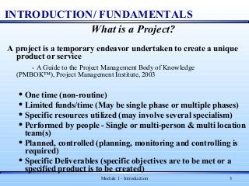
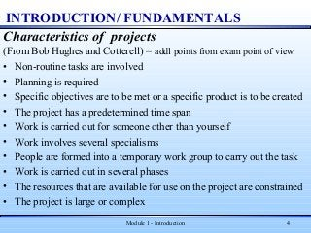

Slide 3
INTRODUCTION TO SOFTWARE PROJECT MANAGEMENT
INTRODUCTION
In the broadest sense, a project is a specific, finite task to be accomplished. Any activity that results in a deliverable or a product.
Projects always begin with a problem. The project is to provide the solution to this problem.
When the project is finished it must be evaluated to determine whether it satisfies the objectives and goals.

Slide 4
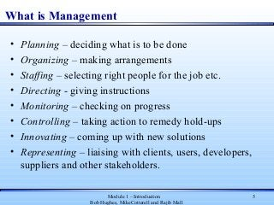
1

Slide 5
1

Slide 6
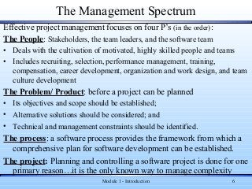

Slide 7
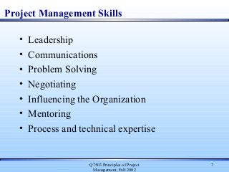

Slide 8
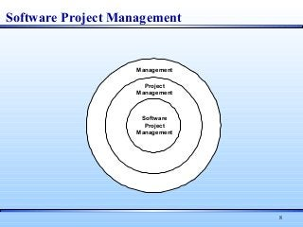

Slide 9
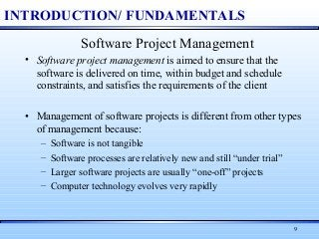

Slide 10
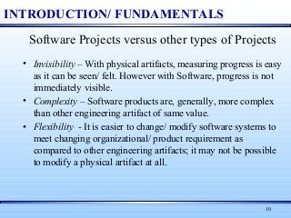

Slide 11
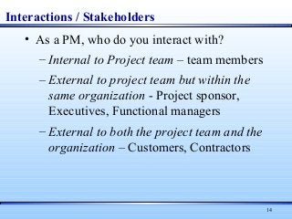
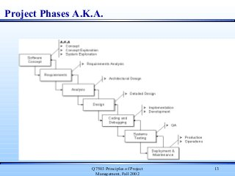

Slide 12
